Slide 1
Kinematics and Dynamics of Robots
Spring Semester 2021
Lecturer: Yoav Golan

Slide 2
Stochastic Path Planning - PRM
PRM = Probabilistic Roadmap
Multiple query – Maps the space regardless of a specific Start and Target. Can be used again and again

Slide 3
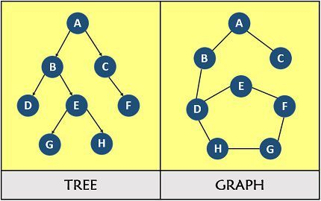
Stochastic Path Planning - PRM
Uses a Graph

Slide 4
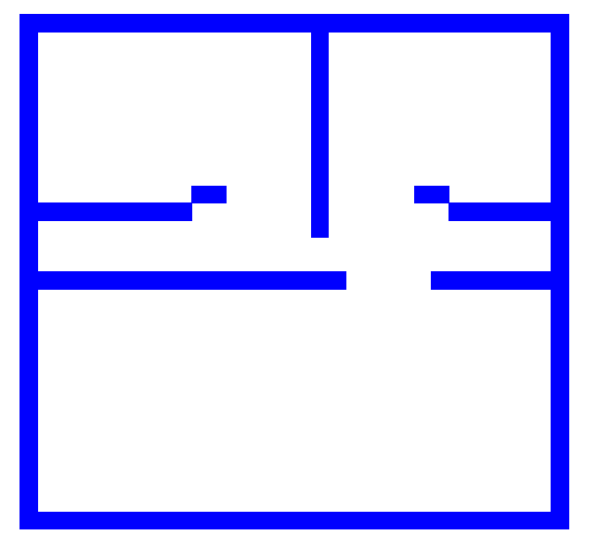
PRM
S
T

Slide 5
PRM
Inputs:
Connection radius
Number of nodes

Slide 6
PRM
Create a random node
1.1. Check if the node collides with an obstacle
1.2. If not, connect the node to all other nodes within the connection radius
1.3. Check each connection for path collision
1.4. Remove any colliding path
2. Repeat 1. for a set number of attempts
3. Choose a Start and Target Node. Perform a graph search to find the shortest path between them.

Slide 7
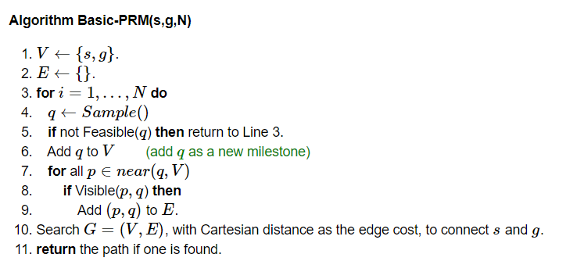
PRM Pseudocode

Slide 8
Assignment #2

Slide 9
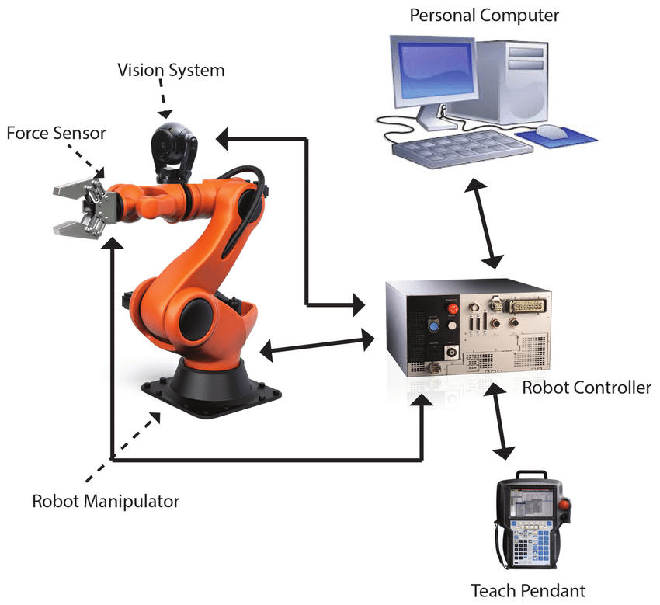
Industrial Robotic Arms

Slide 10
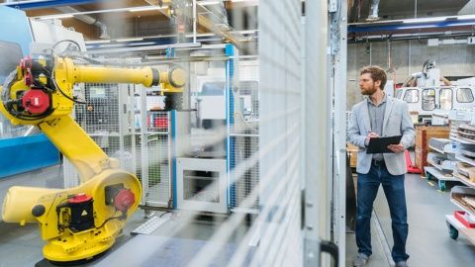
Industrial Robotic Arms

Slide 11
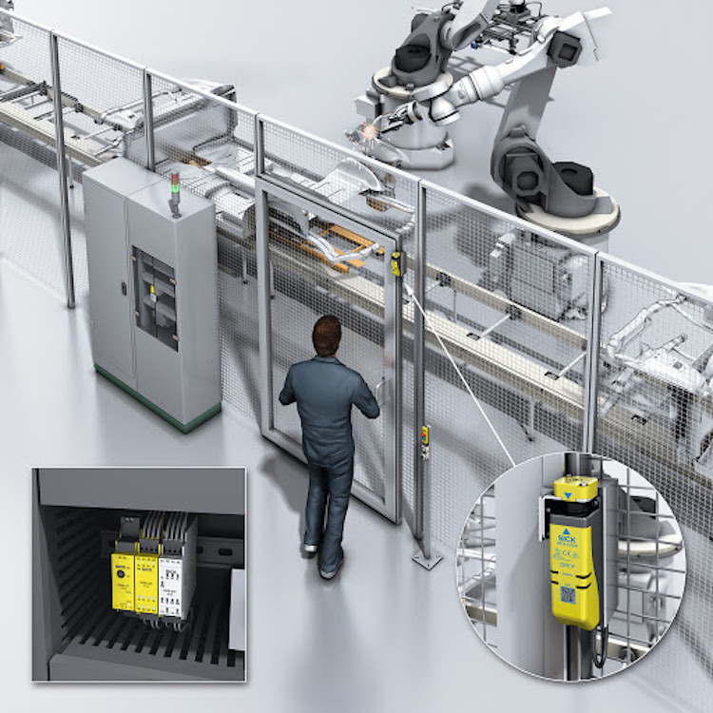
Industrial Robotic Arms

Slide 12
Industrial Robotic Arms
Movement types
Jog
Joint move
Linear Move – (Singularity!)
Circular Move
Follow Path

Slide 13
Industrial Robotic Arms
Teaching a Robot
Programming to Teach Pendant
Programming on a PC Simulator
Direct PC programming
“Limp” direct guidance

Slide 14
Industrial Robotic Arms
Tasks
Pick and Place
Welding
Painting
Machining
Many more

Slide 15
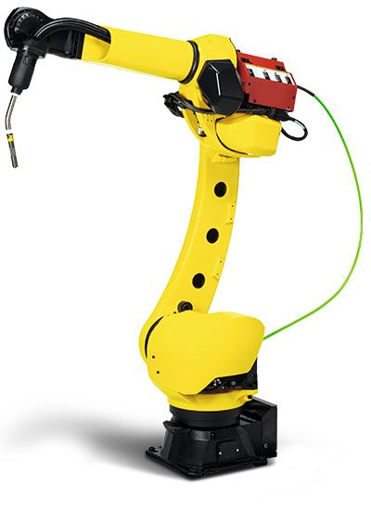
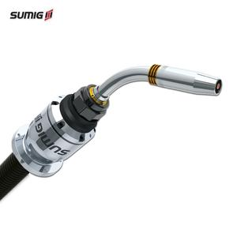
Tools
Welder

Slide 16
Tools - TCP
TCP = Tool Center Point
The most important reference frame!

Slide 17
Tools
Welder

Slide 18
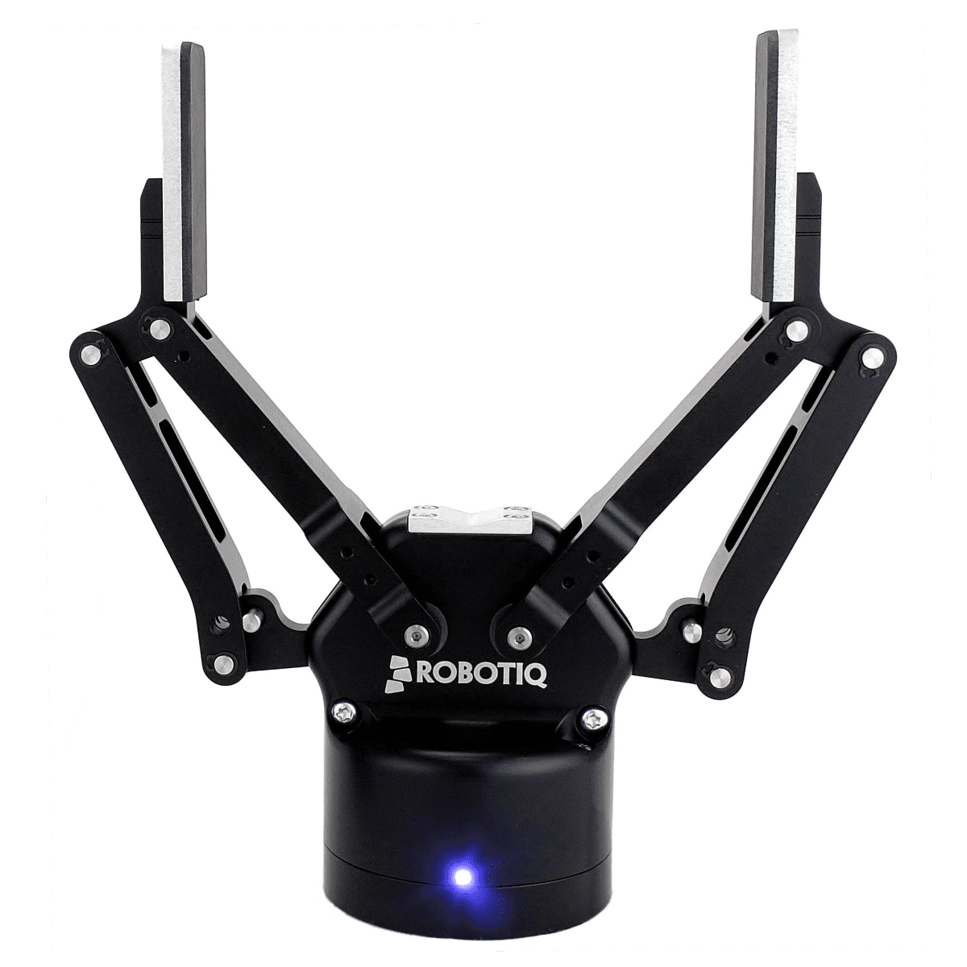
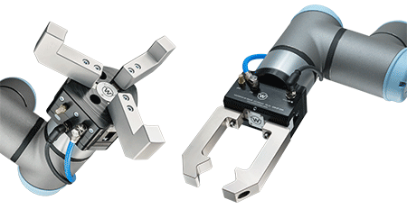
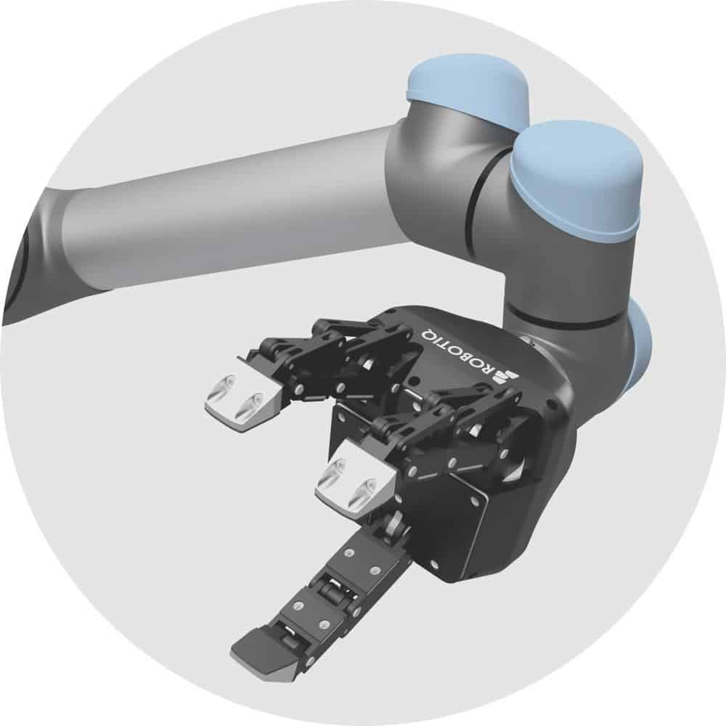
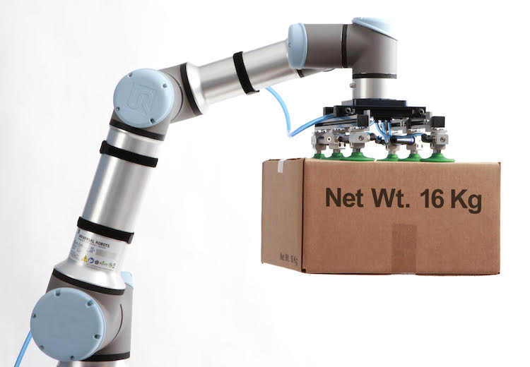
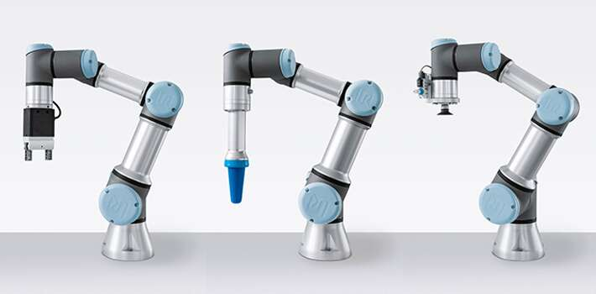
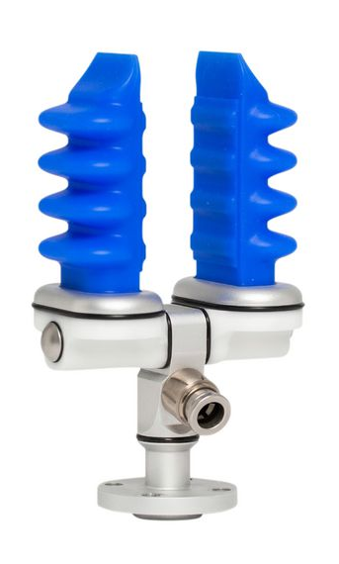
Tools
Gripper

Slide 19
Tools - Grippers
Parallel-Jaw
Vacuum
Custom-Made
Other

Slide 20
Tools - Grippers
Parallel-Jaw
Widely used
Good for exact Pick and Place
“Off the Shelf”
Usually pneumatic

Slide 21
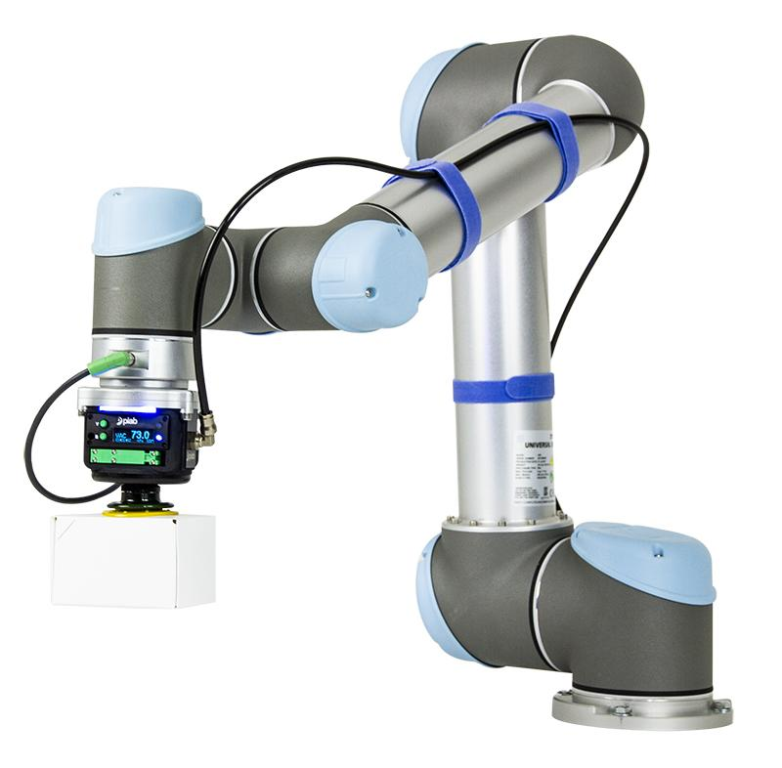
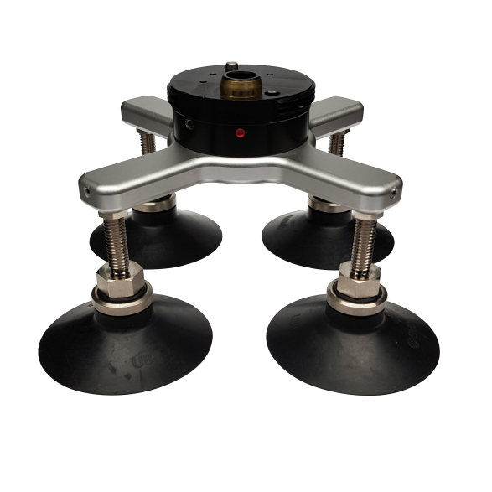
Tools - Grippers
Vacuum
Widely used
Good for vertical Pick and Place
“Off the Shelf”
Usually positive pressure + vacuum ejector

Slide 22
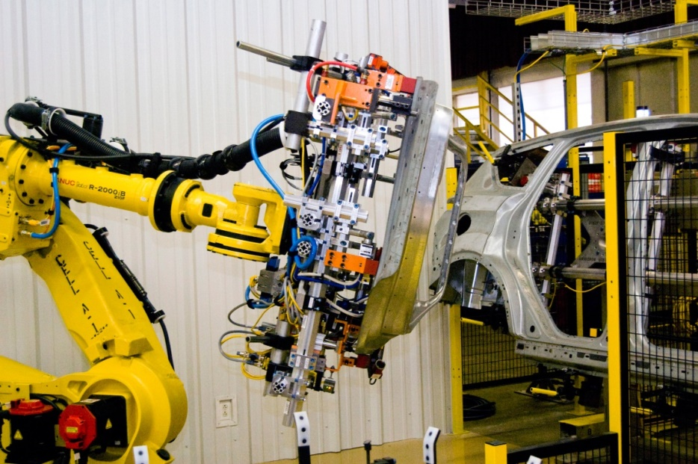
Tools - Grippers
Custom-Made
Works for one part
Good for exact Pick and Place

Slide 23
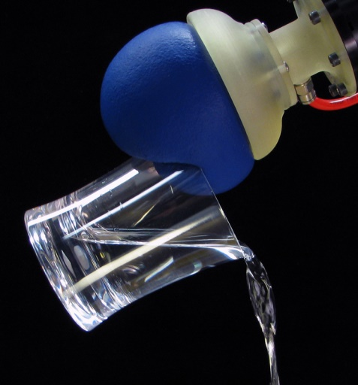
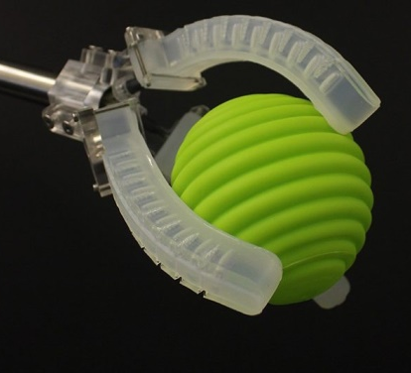
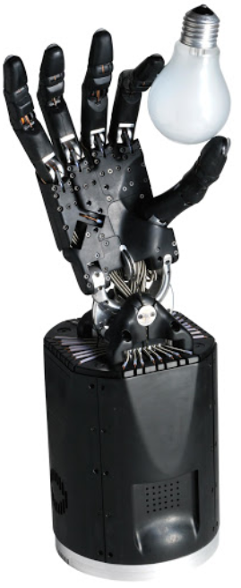
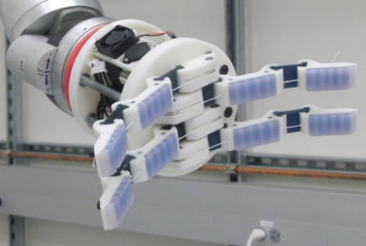
Tools - Grippers
Other
Often soft/compliant
Popular in research
Great videos, poor performance

Slide 24
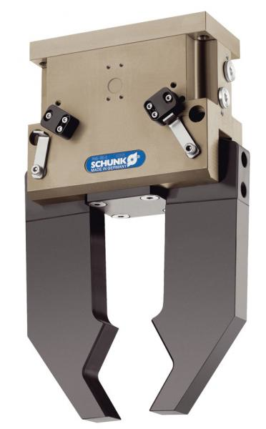
What is Gripping?
An object is gripped when it cannot move, relative to the gripper

Slide 25
What is Gripping?
Configuration space demo

Slide 26
Next week – Install RoboDK

